Slide 1
KEY ASPECTS OF A PLAN TO ADOPT TELEHEALTH TECHNOLOGY TO SUPPORT AND ENHACE PATIENT CARE
Student’s Name
Institution
Course Title
Assignment Title
Date

Slide 2

KEY STAKE HOLDERS TO ATTEND THE MEETING.
Financial stakeholders and medical leaders will be the critical stakeholders attending the meeting on the telehealth technology project.
The Chief officer, chief financial officer, and medical leaders will greatly influence the project achievement factors.
By engaging medical leaders, the information technology leaders will address concerns about the effects of the project and get feedback.
The project will be championed by the chief medical officer in clinical leadership.
Departmental leaders will assist staff in transit to the new telehealth technology (David, 2017).
I have selected the stakeholders because they will assist in attaining the objectives of the project.
Notes:
Medical leaders and financial stakeholders will be attending the meeting to address the issues of concern in the telehealth technology project. Medical leaders will have the most significant influence on the success factors of the project. The chief medical officer will champion the project, and department leaders will help employees transition to telehealth technology. The reason for their selection is the impact they have on reaching valuable end-users.

Slide 3

MEETING ANNOUNCEMENT AND AGENDA
. The meeting will be held on 17th July 2020.
The chief executive officer, chief financial officer, board members, and medical leaders will be expected to attend.
Agenda, one will be a discussion on the financial impact of the project.
Plan two will involve championing the project within the department.
Agenda three will touch on how to assist the nurses in transit to telehealth technology.
Other issues of concern raised by the stakeholders in the adoption of the telehealth technology will be discussed
Notes:
The meeting will be expected to take place on the 17th of July, 2017. The stakeholders expected to be in attendance include the chief executive officer, chief financial officer, medical leaders, and all the board members involved in the planning process. The agendas to be discussed include the economic effects of the telehealth technology, championing of the project within the healthcare facility departments, and ways of assisting nurses in transitioning to telehealth technology. Also, any matters raised and issues of concern will be discussed within the progress of the meeting.

Slide 4
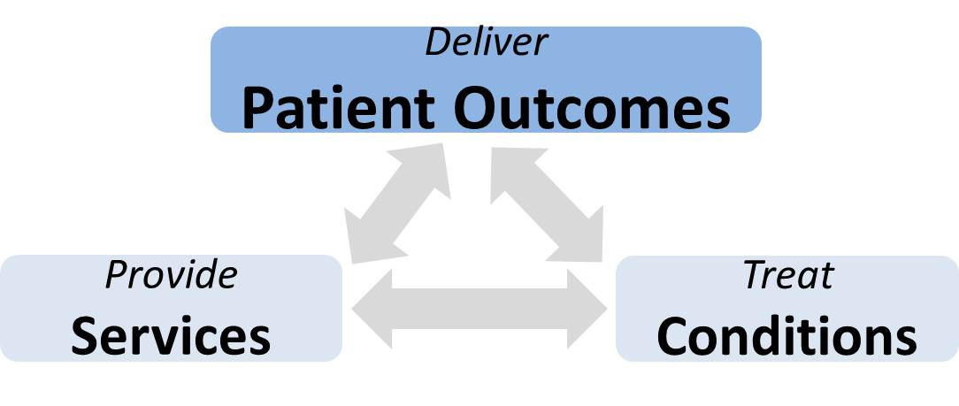
HOW TELEHEALTH WILL SUPPORT ENHANCED PATIENT OUTCOMES AND ORGANIZATIONAL EFFECTIVENESS.
Nurses will be offered with the opportunity to use new tools thus extending quality healthcare and improving patient outcome through improve effectiveness
Patients will gain opportune nursing attention, advancing outcomes and assisting in decreasing the cost of healthcare.
Innovative tools from telehealth technology will improve the access to healthcare facilities.
Patient monitoring will be improved in the hospital and even after discharge.
Patients will be able to connect with nurses and physician from any location for better care enhancing satisfaction (David, 2017).
The technology will reduce patient stress, make follow up easier and reduce financial and psychological burdens.
Nurses will be able to attend to many patients within a short time hence improving effectiveness.
Notes:
Telehealth technology will enhance patient outcomes and organizational effectiveness by ensuring that nurses are provided with new tools for extending quality care. Also, suitable attention will be offered to patients helping reduce costs and improve access to healthcare facilities. Additionally, monitoring patients will be made more accessible, and patients will be able to connect with nurses from any location. Moreover, patient stress will be reduced and the psychological and financial burdens thus improving the level of quality care. Furthermore, nurses will attend to many patients in a short period.

Slide 5

OUTCOME MEASURES TO BE USED BY THE ORGANIZATION TO DETERMINE EFFECTIVENESS OF TELEHEALTH TECHNOLOGY
Access to care involves the ability of telehealth to offer healthcare services to remote patients effectively.
The ability to offer specialized feasibility services like emergency care
Acceptability, accommodation, accessibility, availability, and affordability of care.
The telehealth project's financial impact on patients, the broader community, patient caregivers, the more extensive healthcare system, and insurance providers.
Friendliness and effectiveness of the project to patients, acre team members, and the community at large.
Type of care provided, technology adopted, environmental and socioeconomic setting resulting in acceptance and effectiveness.
Notes:
The evaluation measures for evaluation of the telehealth technology will involve access to care for patients in remote locations and the provision of feasibility services. The evaluation process will also include the financial impacts of the project and effectiveness and friendliness to patients, care team members, insurance providers, and the community. Moreover, the evaluation will be based on the type of technology adopted, the kind of care provided, and socioeconomic and environmental settings that influence acceptance and effectiveness.

Slide 6

PATINENT CONFIDENTIALITY AND PRIVACY CONCERNS ASSOCIATED WITH TELEHEALTH TECHNOLOGY
Privacy and security concerns require the identifiable health information to be encrypted for reading by authorized individuals only.
Any data gathered from in-person settings must be to deliver care through telehealth.
Security and privacy during the collection, sharing, and storing patient data electronically (Hale & Kvedar, 2014).
Obligatory forwarding of medical records to care providers and restrictions on the use of the information without the patient’s consent.
Making patients aware of probable privacy and security risks as an ethical obligation for confidentiality.
Restriction on disclosure of information on the website and in-patient examination requirement.
Notes:
The privacy and confidentiality concerns involve encryption of identifiable health information by authorized persons only, and use of information collected from the in-person environment for telehealth delivery. It also includes privacy and security during storage, sharing, and collection of patient information. It also includes compulsory forwarding of medical records to the relevant healthcare providers and restrictions on the use of the information without the patient's consent. Moreover, it involves informing patients on the potential security and privacy risk for confidentiality and restricting disclosure of patient data in websites and in-patient examination requirements.

Slide 7

RESPONSIBILITIES OF STAFF FOR IMPLEMENTING ACTION PLAN
Improving service approach to quicken social mechanisms connected to the normalization of telehealth technology.
Employing the telehealth technology in the routine services for clinical and cost-effectiveness.
Participating in training before interacting with patients through telehealth technology for successful implementation.
Analyzing outcomes and identifying gaps and opportunities to improve the technology.
Integrating telehealth technology with electronic medical records for better data understanding and efficiency.
Developing an implementation timeline depends on the telemedicine program's objectives and the size of the healthcare facility.
Notes:
The responsibilities of staff in the implementation of the action plan for telehealth technology include improving service approach for faster social mechanisms associated with normalizing the technology. It also includes employing the technology in routine services for effectiveness and patriating in training before using the technology to interact with patients. It also involves the identification of gaps and opportunities for improvement and analyzing the outcomes as wells as integrating the technology with electronic medical records for efficiency and data understanding. Moreover, staff must develop an implementation plan depending on the healthcare facility size and objectives of the technology.

Slide 8
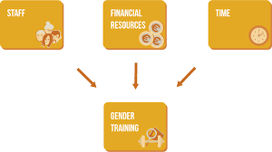
RESOURCES NEEDED TO IMPLEMENT AN ACTION PLAN
Active identification of critical stakeholders and end-users of telehealth technology involved in the planning process.
Description of the community vision and mission before implementing telehealth technology.
Developing strategies on the implementation of the mission and objectives of telehealth technology.
Networking and cooperation among the involved parties.
Provision of the required financial resources.
Provision of the necessary information systems and training of staff.
Notes:
For the action plan to be implemented, various resources are needed. The resources include providing financial support, information systems, and a description of the mission and vision of both the community and healthcare facility before implementing the action plan. Other resources include coordination and networking among the stakeholders and end-users of the technology and involvement of the relevant parties in the planning process. Additionally, strategies must be developed on the implementation of the objectives and mission of telehealth technology.

Slide 9

ADVANTAGES OF TELEHEALTH TECHNOLOGY TO DOCTORS AND PATIENTS
Telehealth technology will result in the improvement of customer-based care.
Healthcare providers will be able to engage with patients with distant monitoring.
The access to care will be expanded to reach more patients.
The clinical workflow will be excellent practice efficiency will increase.
Telehealth technology is less time-consuming for the provider and patients, and it will result in increased practice revenue.
The quality of healthcare, particularly in remote environments, will be improved.
Notes:
Telehealth technology is associated with various benefits such as improved consumer-based care, patient engagement in distance monitoring, expansion of care to reach more patients, and advancement in clinical workflow, resulting in practice efficiency. Telehealth technology will also result in the improvement of the quality of healthcare in remote settings and increased practice revenue due to the less amount of time spend for the patient and health providers.

Slide 10

STEPS NEEDED TO DEPLOY TELEHEALTH TECHNOLOGY
Assessment should be done on the capabilities followed by an analysis of the community needed to be sure of what to provide.
Conduct self-assessment within the organization and identify the strengths and address the needs of the community.
Alignment of the telehealth objectives with the mission of the healthcare facility.
Development of an implementation timeline.
Obtaining administrative support to get resources and motivate patients to use telehealth technology.
Training healthcare providers, analyzing outcomes and integrating telehealth with other systems.
Notes:
The first step in telehealth implementation involves the market assessment of the organization's capabilities and the analysis of community needs. The next step consists of conducting self-assessment within the organization to identify strengths and comply with the community's requirements. The third step involves aligning the objectives of telemedicine with the healthcare facility mission. The fourth step includes the development of an implementation strategy, followed by the attainment of administrative support to acquire resources and emphasize the significance of telehealth technology to patients. The last step involves training the healthcare providers, integrating the technology with other systems, and analyzing the outcomes.

Slide 11

PLAN FOR CHANGE AND COUNTERING POTENTIAL RESISTANCE
The limitations to telehealth equipment, organizational and technological barriers to sharing patient data should be addressed.
Engaging personnel and creating awareness among staff members and implementing change in several stages of the action plan.
Improvement in the efficiency of resources to support service delivery (Taylor et al. 2015).
Providing solutions to challenges during the assessment of the suitability of telehealth for patients and effectively engaging employees.
Addressing increased workload and issues related to patient care and job roles.
Ensuring adequate training of staff and communicating change effectively.
Notes:
The healthcare facility must be prepared for change and potential resistance during the implementation of the new technology. The solution includes developing strategies to deal with telehealth equipment limitations through proper financing, creating awareness, and engaging more staff members in the planning process. Also, better ways should be developed to assist in assessing the suitability of telemedicine to patients. Additionally, the efficiency of resources to support service delivery should be improved. Moreover, concerns of increased workload need to be addressed and issued associated with patient care and work roles. Lastly, there should be practical training of staff members on how to use the technology.

Slide 12
REFERENCES
David Kushan. (2017). How to Identify Key Stakeholders for a Healthcare IT Project. Retrieved from https://www.healthcareis.com/blog/how-to-identify-key-stakeholders-for-a-healthcare-it-project
Hale, T. M., & Kvedar, J. C. (2014). Privacy and security concerns in telehealth. AMA Journal of Ethics, 16(12), 981-985
Taylor, J., Coates, E., Wessels, B., Mountain, G., & Hawley, M. S. (2015). Implementing solutions to improve and expand telehealth adoption: participatory action research in four community healthcare settings. BMC health services research, 15(1), 529.

